Slide 1
@FlourishCIC #InvestinWomenChangemakers
Nickala Torkington - MACC Event
@Nickala 5 Nickala@flourishtogether.co.uk

Slide 2
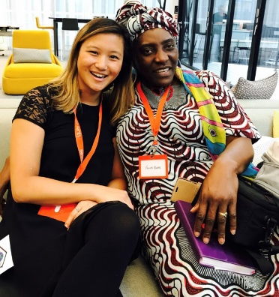
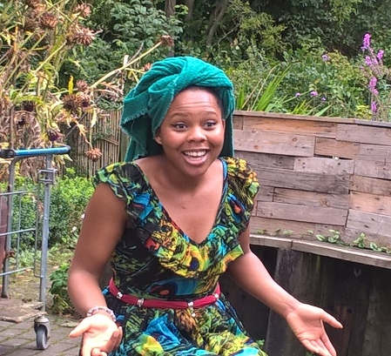
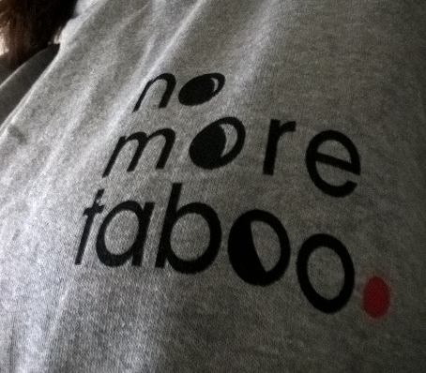
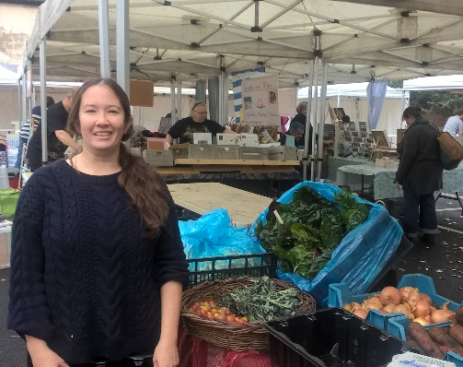
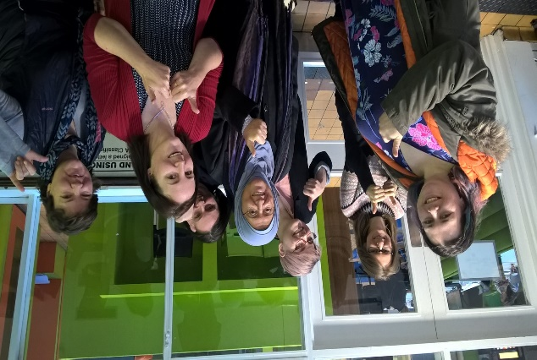
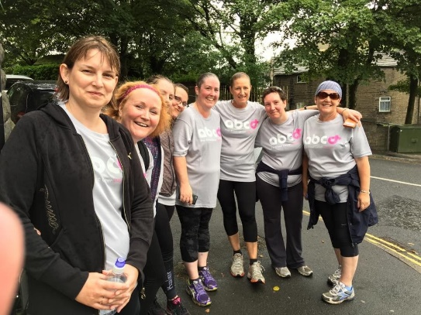
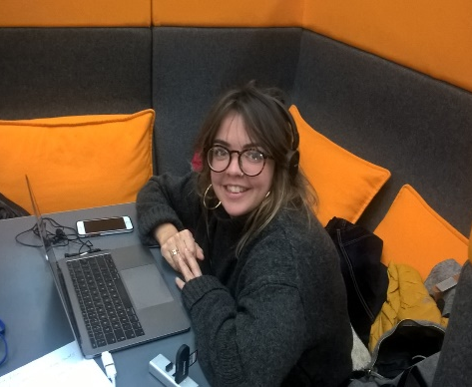
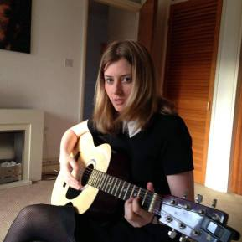
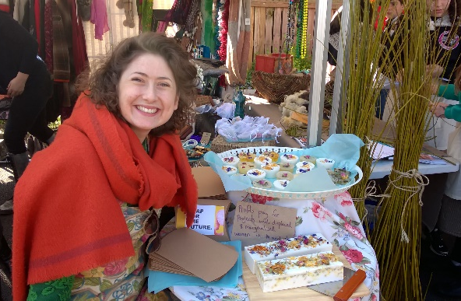
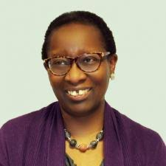
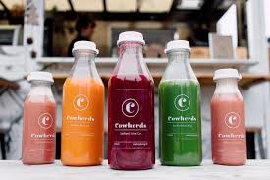
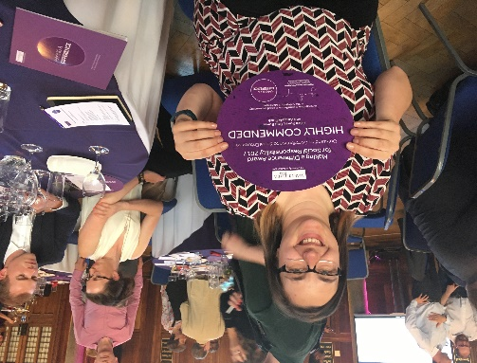
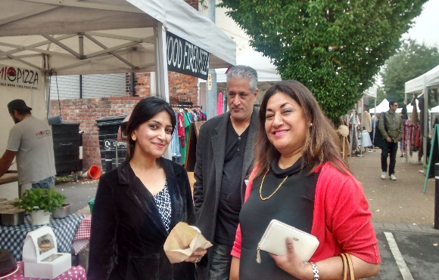
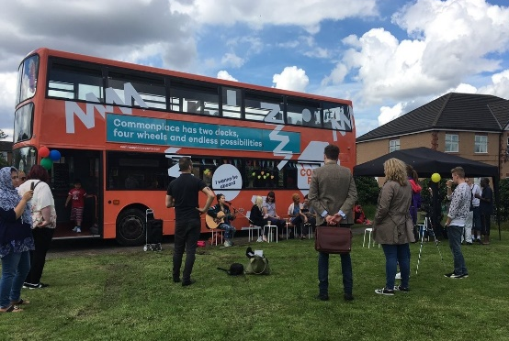
We #InvestinWomenChangemakers- Help support more
@FlourishCIC PURPOSEFUL – IMPACTFUL – SIGNIFICANT – ENTREPRENEURIAL – SUSTAINABLE
Notes:
What kind of changemaker might you be? Campaigner, entrepreneur intrapreneur, mentor – where might your need to act come from? expert by experience or by oberservation/networks/ career position?

Slide 3
Get Involved!
Events
Crowdfund & Investment
Mentoring
Online Community
Research & Policy
Partnership Programmes
Consultancy – organisational development
If you would like any further information please contact: Nickala Torkington on 07815 023 363
Jo McGrath on 07912 758 486
Message us : nickala@flourishtogether.org.uk
@FlourishCIC #InvestinWomenChangemakers

Slide 4
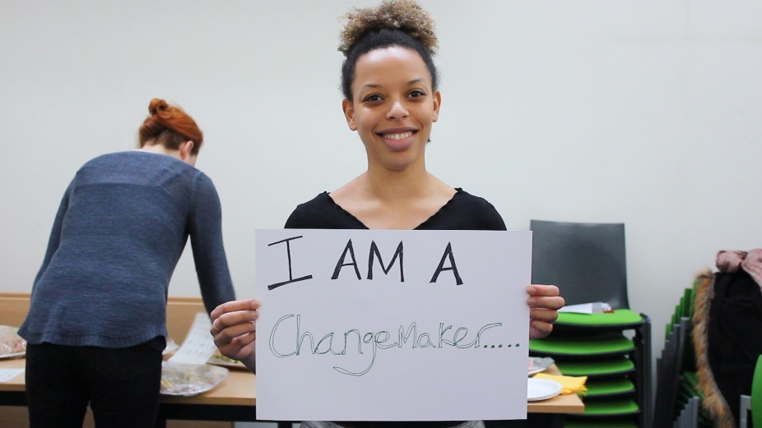
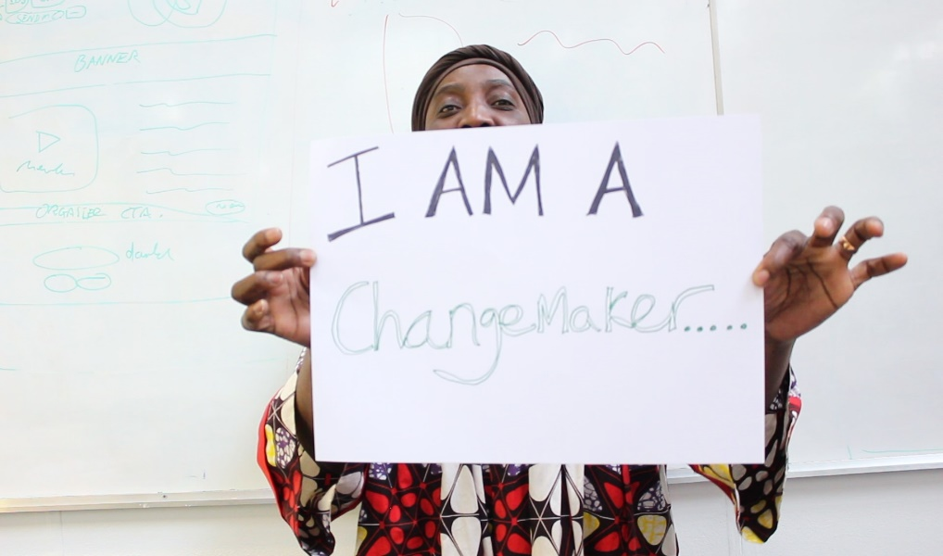
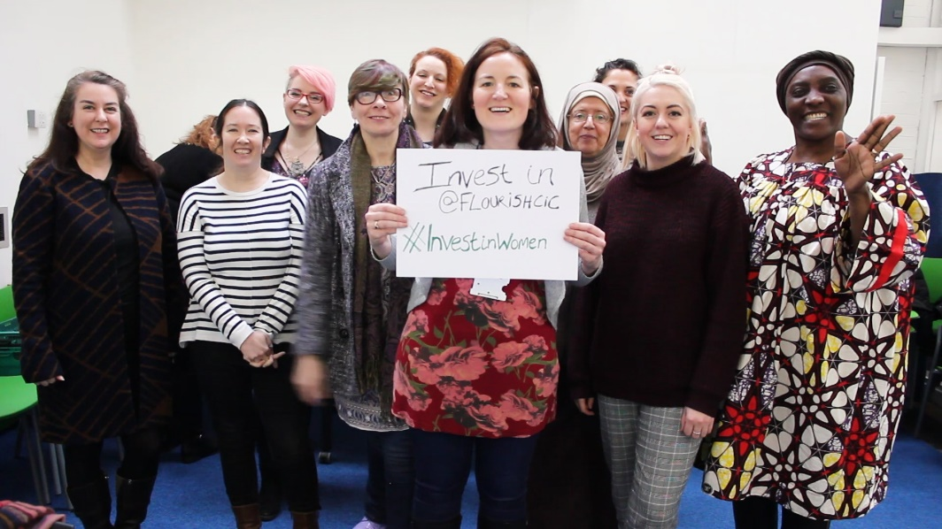
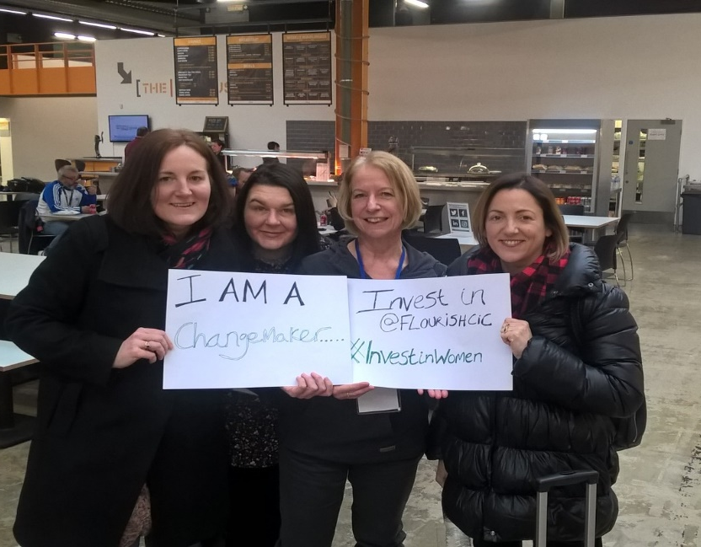
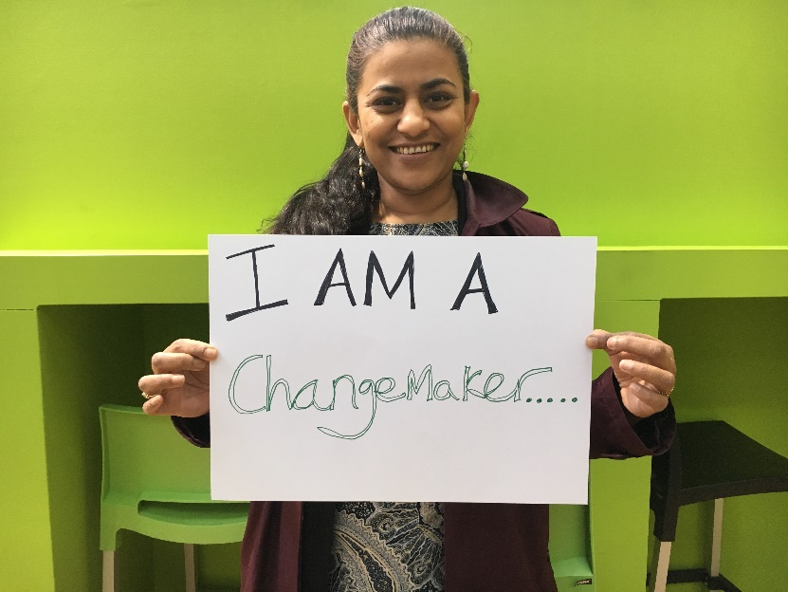
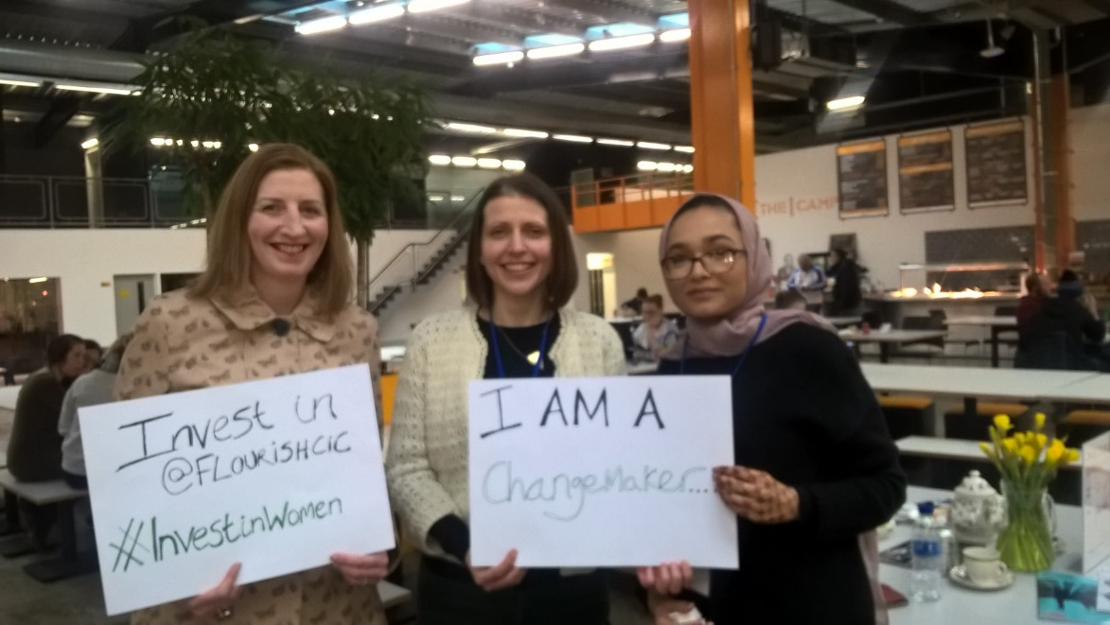
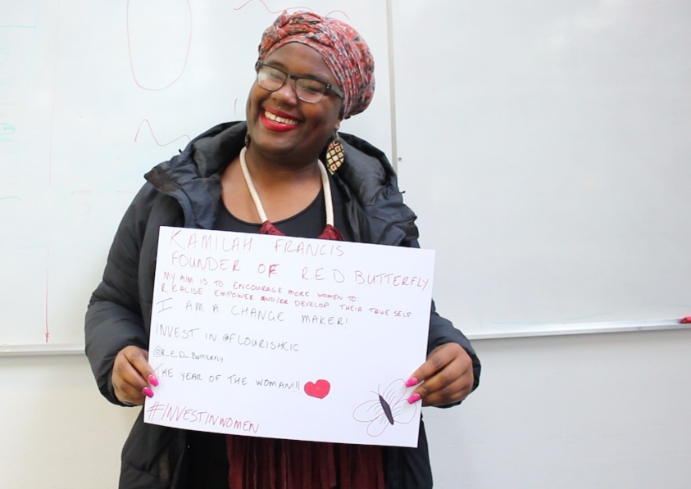
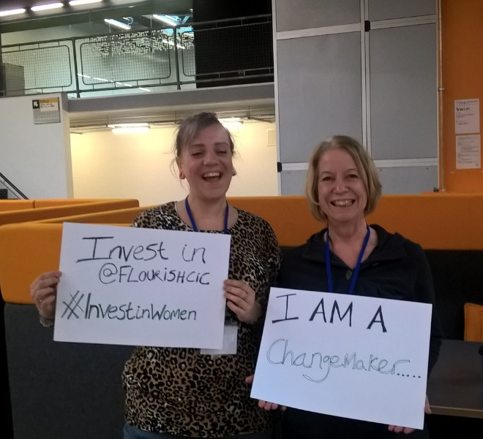
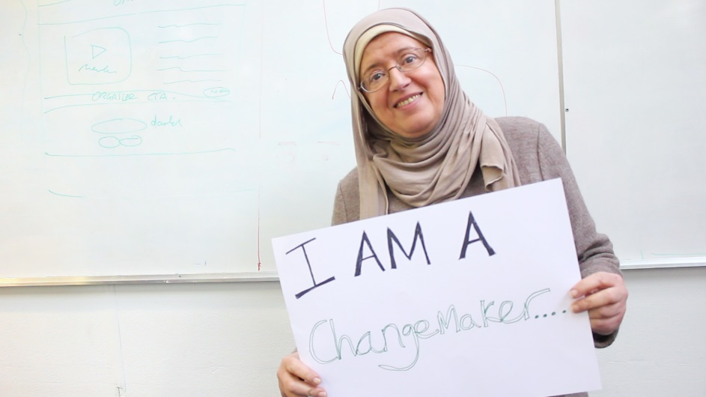
#InvestinWomenChangemakers

Slide 5
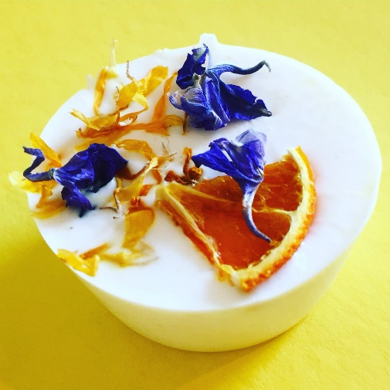
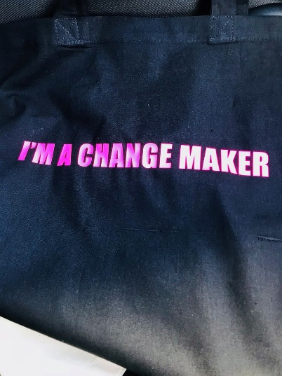
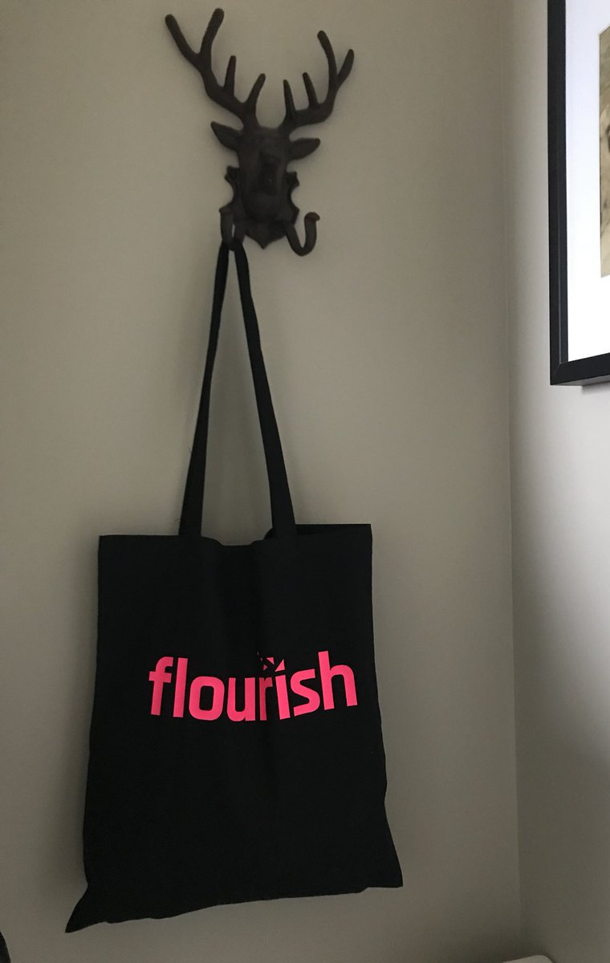
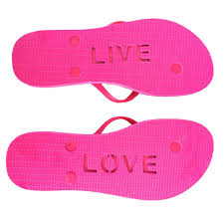
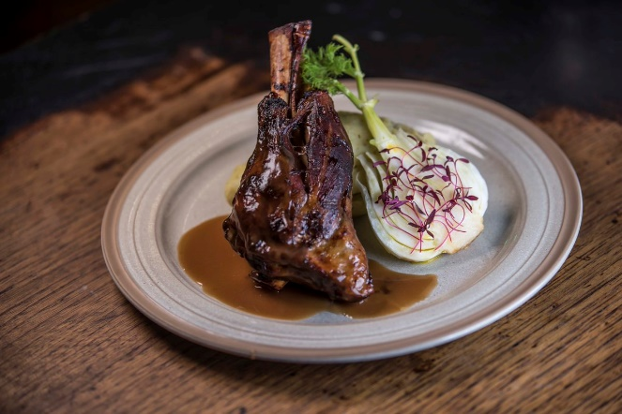
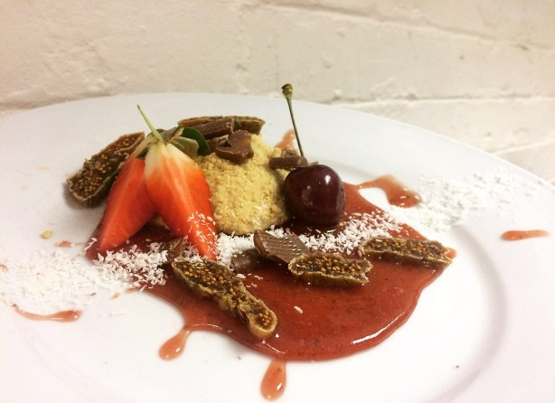
rewards
Coming Soon…….
#BuySocial #InvestinWomenChangemakers @FlouishCIC

Slide 6
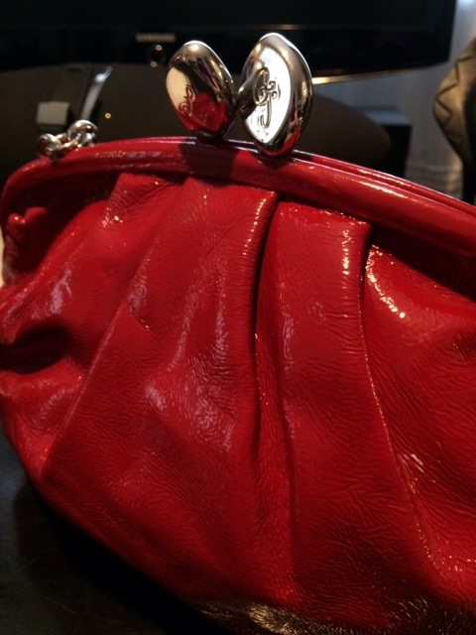
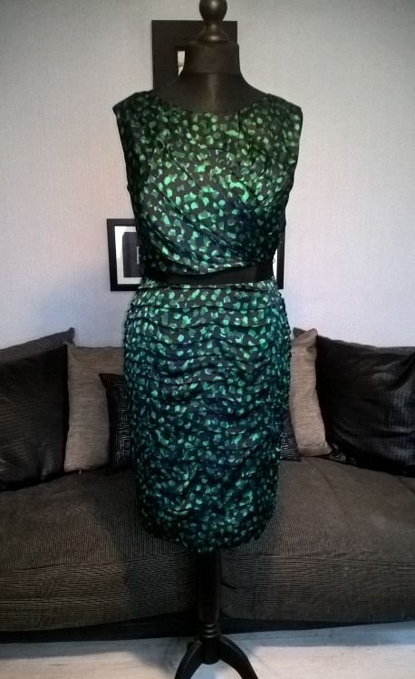
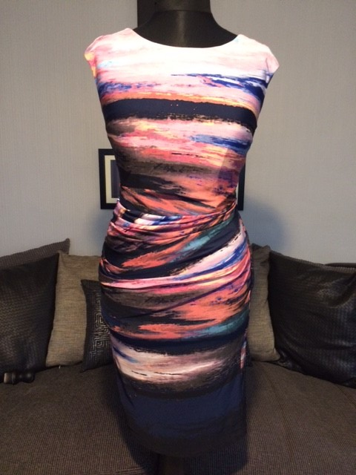
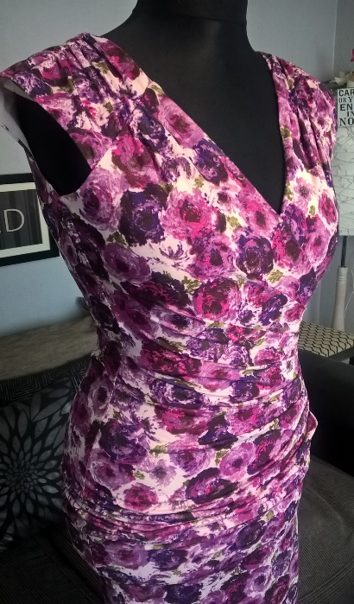
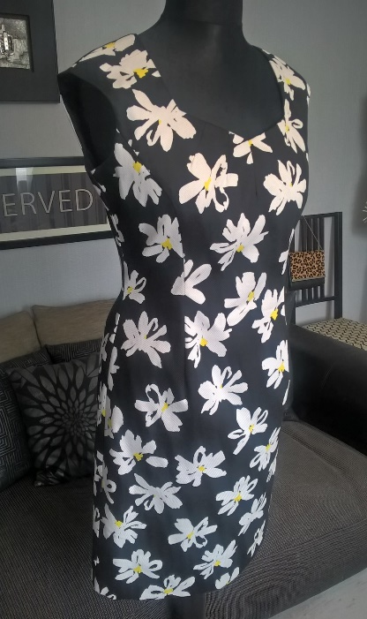
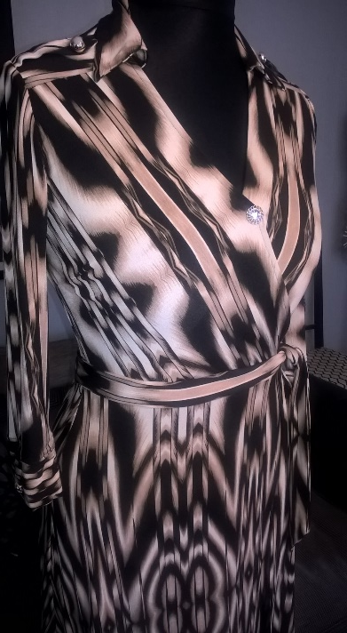
Handbags
&
Gladrags
Online sale
13th – 15th April!
Coming Soon…….
GRAB A BARGAIN and #InvestinWomenChangemakers

Slide 7
@FlourishCIC
Corin Bell @RealJunkFoodMcr
“Flourish CIC make a real, positive difference in the lives of the women they support, and much more widely in and around Manchester because of the amazing projects these women go on to develop. I'm proud to support women change makers in Manchester. Flourish CIC are a credit to our city!!”
helping women entrepreneurs make a difference #InvestinWomenChangemakers

Slide 9
@FlourishCIC
0% Matchfund
50% Matchfunded by Santander
102 backers
77 backers
47 backers
helping women entrepreneurs make a difference #InvestinWomenChangemakers

Slide 10
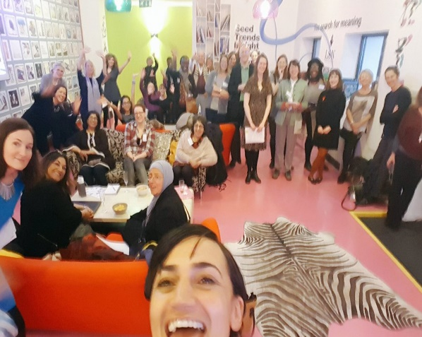
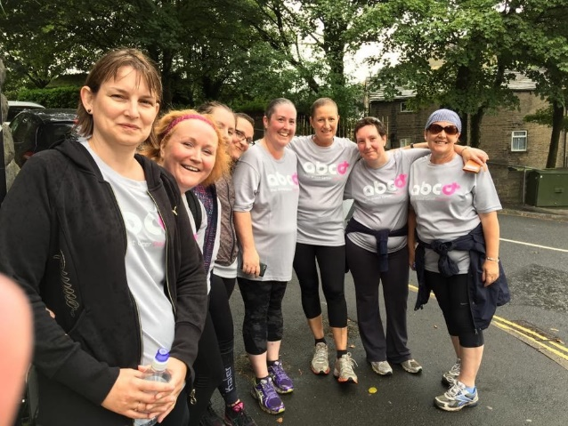
Case studies of Women Changemakers
Next Mentor-a- thon 11th July 2018
Geraldine Esdaille, Freedom to Be benefitted from the Mentor-a-thon and secured £300 in 2016 to invest in herself and her developing social venture. "This year I have seen spectacular benefits from the support and mentoring that I have received. As well as continuing to provide regular sessions helping women with domestic violence and abuse issues, I started working for The Women's Resource Centre, an amazing organisation in the women's sector. I am also really proud to have won a Winston Churchill Travelling Fellowship that provides a remarkable opportunity to travel to the USA and research what I am passionate about, and to top it all off, I have been shortlisted for the Northern Power Women Awards 2017, it's incredible!
Jo Taylor, ABCDiagnosis attended the Mentor-a-thon and received £300 of investment and a mentor in 2015. In spite of living with secondary breast cancer she runs an advisory and advocacy social venture helping people be better aware of the needs of those living with cancer and secondary cancer. "The support I've had so far, has helped me make useful connections, paid for some marketing materials and I'm in the process of securing further funding from a charitable trust to hold up to 4 residential retreats per year, as well as develop day sessions for local patients living with cancer".

Slide 11
Case studies of Women Changemakers
Next Mentor-a- thon 11th July 2018
Corin Bell, Real Junk Food MCR attended our mentor-a-thon in 2016 rather than cash investment we have purchased over £600 of catering from their business at events we have run. Corin attended our Crowdfunding peer learning session and launched a Crowdfund campaign, with our support and secured over £39,000 to open their first restaurant in 2017. “The Mentor - a - thon was a great opportunity to talk out my idea and gain honest feedback. Their support to pilot my services successfully and be one of our first clients gave me confidence and resources. Flourish CIC make a real, positive difference in the lives of the women they support, and much more widely in and around Manchester because of the amazing projects these women go on to develop. I'm proud to support women change makers in Manchester. Flourish CIC are a credit to our city!!.”
Iyabo Fatimilehin, Just Psychology was supported via the Mentor –a- thon in 2016 and secured £300 to develop a digital strategy and mentoring support. Their aim is full participation of all Black and minority ethnic (BME) children and their families in an equal and fair society through the achievement of a significant improvement in psychological health and mental well being, and the prevention of problems with mental health.
"The support I've received has helped me make useful connections, paid for consultancy support and built my knowledge and confidence in social investment readiness."

Slide 12
@FlourishCIC #InvestinWomenChangemakers
@Nickala5 Nickala@flourishtogether.co.uk

