Slide 1
No More Painted Fences Building Great Partnerships with Companies 9th May 2018

Slide 2
About us
Victoria Symes and Norma Young:
Fundraising consultants – Impact Fundraising
Institute of Fundraising North West Committee
Hayley Hughes (case study):
Citizens Advice Manchester

Slide 3
About your corporate fundraising

Slide 4
Corporate fundraising opportunities
54% of charities raise up to £500,000 p/a
Consistent increase 12% p/a 2012-15
Wealth, expertise, profile
Trusts/statutory declining
(Sources: DSC/IoF)

Slide 5
Case Study: When corporate fundraising goes wrong!
19 companies on board
Chief Executive & fundraiser v involved
Generated £30,000 in cash
Took approx.£27,000 of staff time
Cost of equipment + lost venue hire
Outcome = one highly painted fence!
Started to involve volunteers in reading sessions and fundraisers instead

Slide 6
Common Mistake #1: Not being ‘corporate fundraising-ready’

Slide 7
Are you ready?
Understand your charity’s USP and proposition
Have companies and their staff heard of you/care about you?
Can you offer meaningful volunteering?
Can you offer profile?
Do you hold events?
Can you inspire and be credible?

Slide 8
Are you ready?
Get your board involved
Has the board got good contacts?
Are they prepared to get involved?
If a company wanted to meet or visit, would the board be available to attend?
Have a plan
Get the right resource in place
DON’T BE AFRAID TO PUT CORPORATE FUNDRAISING ON HOLD UNTIL YOU ARE READY

Slide 9
Common Mistake #2: Not Being Realistic

Slide 10
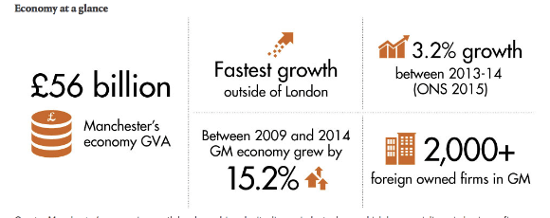
Regional picture
2013 – 2.5% corporate fundraising to North West
Corporate growth in Manchester – but still quite ‘young’ corporate giving functions
Figure 10: Snapshot of Greater Manchester Economic Growth

Slide 11
Being realistic!
70% corporate donations <£5k / 78% <£20k
Only 7% worth over £1 million
Takes 5 years to build, 10 yrs to reach fruition
Charity turnover | Average Annual
Under £1 million | £53,658
£1-5 million | £376,522
£6-10 million | £912,456
£11-20 million | £1,210,362
£21-50 million | £1,657,416
£50 million+ | £2,424,347

Slide 12
Your solution
Create an evidenced strategy for growth over time
Set realistic aims e.g. £5,000 first year
Measure progress as well as income e.g. no. of new relationships built
Make it clear who does what, and how
You and your board will all be on the same page; you will know what success looks like

Slide 13
Common Mistake #3: Not Costing Your Corporate Fundraising Activity

Slide 14
Time and resource
1 fundraiser to raise £300k - once established!
A lot of ‘community’ fundraising

Slide 15
Typical ROI
Source: Fundratios

Slide 16
Your solution
Create a corporate fundraising policy
Identify meaningful volunteering opportunities
Charge for team building days
Say ‘no’!
Allocate a junior staff member to manage
Involve them in fundraising challenges
Calculate the ££ value of their input
You will save money + companies will give more

Slide 17
Common Mistake #4: Thinking Every Company Wants to Partner With You

Slide 18
Understanding a business’s interests is vital
Has to benefit their business
Often have set CSR policies
They want to hear what you have to offer them e.g. team motivation and skills; profile; access to customers

Slide 19
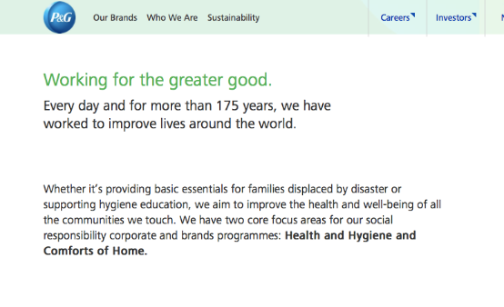
For example

Slide 20
Your solution
Do your research!
CSR policies online
Research their business interests
Prepare for every meeting
Get to know them
Rule out the ones not relevant to you
Your time will be better used; your chances of success increased

Slide 21
Case Study: Listening to them
Digital art
Major online retail company
Thought they wanted: staff volunteering; access to clients/customers
They actually wanted: access to future employees
Outcome = one positive partnership

Slide 22
Common Mistake #5: Forgetting to build a relationship

Slide 23
The value of existing relationships…

Slide 24
A meeting is just the start…
Can take 3 years to get success
They may want to test you
Staff engagement is crucial to maximising the fundraising income being generated
Motivation is key to keep them coming back

Slide 25
Your solution
Have a strong stewardship programme
Report regularly – impacts/case studies
Visit and motivate
Involve staff at all levels
Promote on social media
You will grow and retain relationships far quicker than gaining new ones

Slide 26
If you want more than a painted fence…
Make sure you are fundraising-ready:
know what you can offer
get your board involved
get the right resource in place
Create an evidenced strategy for growth
Create a corporate fundraising policy
know what things cost
find meaningful volunteering opportunities
don’t be afraid to say no
Do your research – and listen
Look after your corporate relationships

Slide 27
Get in touch if we can help
Victoria Symes
Director
victoria@impactfundraising.co.uk
Norma Young
Development Manager
norma@impactfundraising.co.uk
And come and find us for more information on the Institute of Fundraising North West

Slide 28
Case Study: Citizens Advice Manchester
Hayley Hughes, Business Development Manager

