Slide 1
Working with hospitals
Janette Linacre, Executive Director

Slide 2
What is a Home Improvement Agency (HIA)?
Non medical, low level, housing related support
Person centred, holistic approach
Promoting independence, choice and wellbeing
Helping to make sure homes are warm, safe, secure and adapted to the resident’s needs
Facilitating hospital discharge and preventing readmission

Slide 3
Manchester Care & Repair
Independent HIA, founded in 1991, Registered Charity
Range of free services for over 60’s
Home from Hospital follow up
Hospital discharge support
Handyperson/falls prevention (including child accident prevention in North CCG patch)
Technical support with repairs and adaptations
Home visiting caseworker service
Funded by MCC Strategic Housing, MHCC and various charitable trusts

Slide 4
Home from Hospital (since October 2012)
Follow up call to all over 60’s discharged after hospital stay or A&E visit (NMGH, MRI and UHSM)
Check that the patient is doing OK
Explain the range of services MC&R can offer
Take a referral or send information leaflet
Staff have honorary contracts/secondments and follow up calls are made from NMGH, MRI and UHSM sites.
In 2016-17 20,516 patients called, 11,608 contacted, 1,127 accepted service
Over 60’s 30 day readmission rates monitored

Slide 5
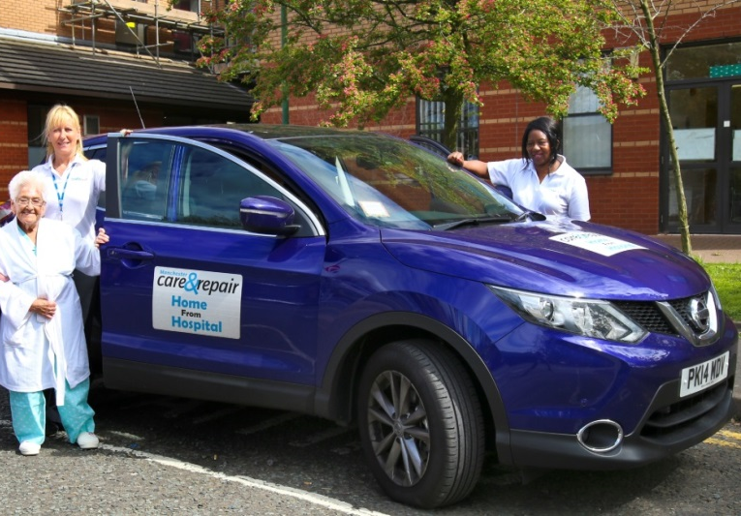
Discharge Support Service
Since April 2013
Recommissioned 1st Oct 2017

Slide 6
Discharge Support Service
North Manchester General Hospital (since April 2013)
7 day working 12.00 – 20.30
Personalised discharge support for vulnerable or isolated patients
Escorted home and settled in
Check the home is safe and warm
Small practical tasks
Onward referral and telephone follow up
1,692 patients supported in 2016-17 at NMGH
6 month pilot at MRI Oct16 – Mar17

Slide 7
Handyperson/Falls Prevention (since August 2012)
Open access – no means test, cross tenure
Comprehensive home assessment at initial visit
Safety, security, disrepair, energy efficiency
Installation of free falls prevention equipment
Onward referral for technical or caseworker support
Small repairs and works to facilitate hospital discharge
7070 jobs/visits in 2016-17 (30% minor adaptations, hospital discharge)
DCLG financial benefit tool results for 2016-17
114 falls prevented, £1 saves £1.36

Slide 8
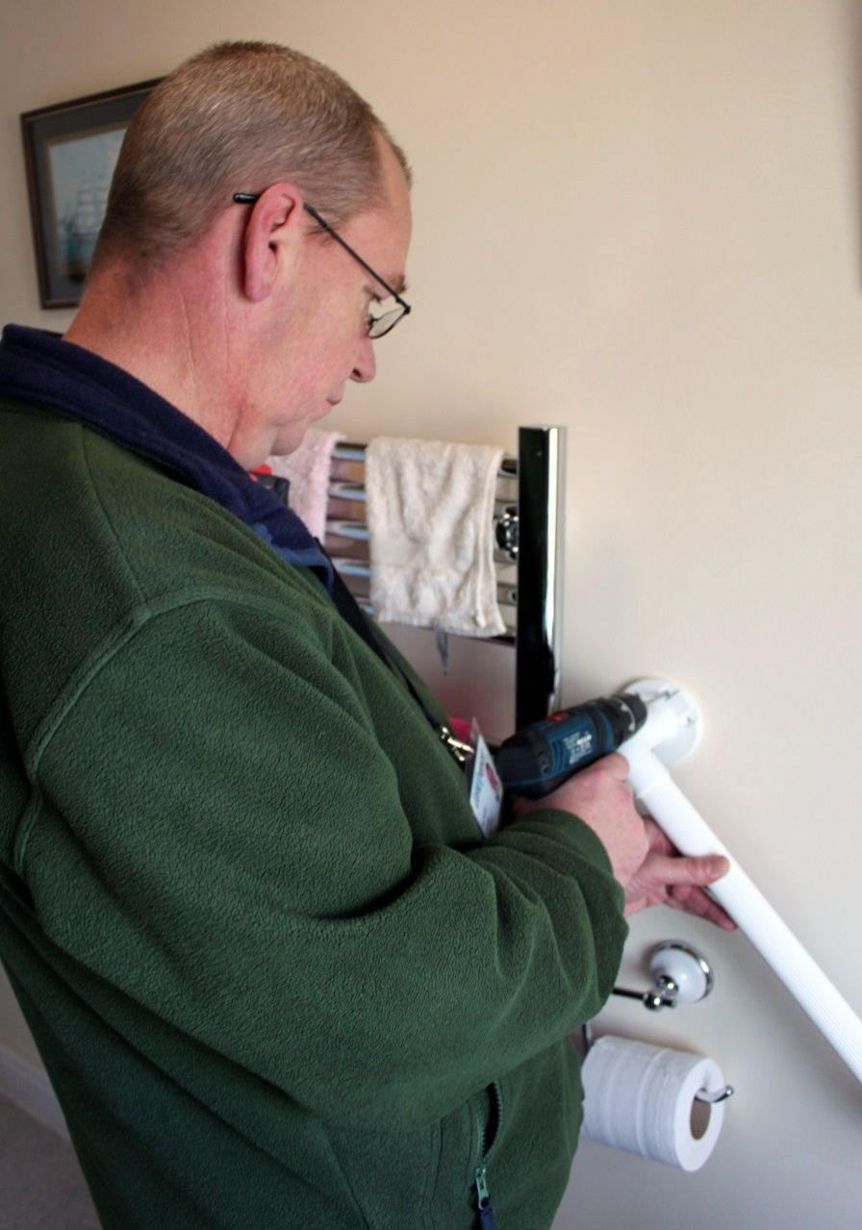

Slide 9
Technical Support
Survey property
Draw up Schedule of Works
Obtain competitive quotes from approved contractors
Engage the selected contractor
Supervise works on site
Final inspection and sign off
Maintain a list of robustly vetted contractors for clients wishing to proceed independently but avoid cowboy builders
Delivery of emergency heating repairs/boiler replacements funded from a variety of sources including North CCG welfare grant

Slide 10
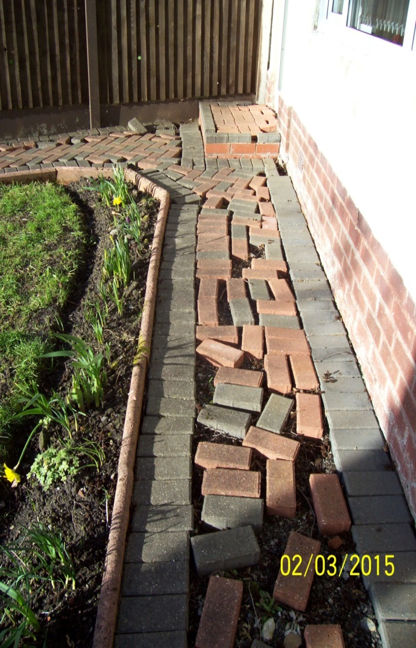
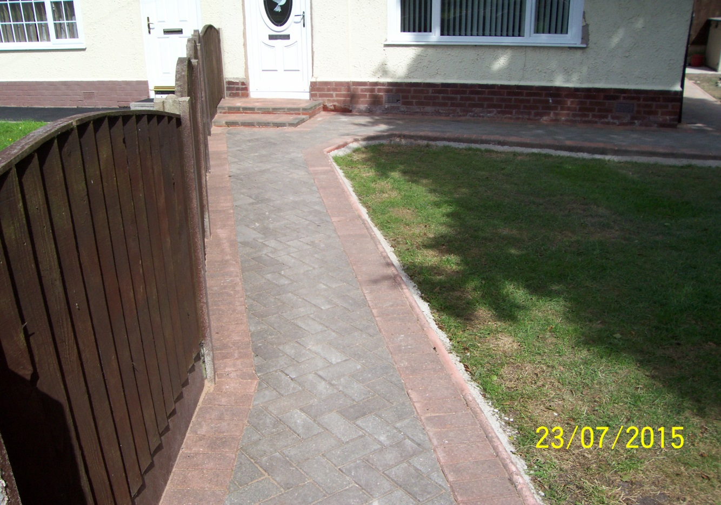
Technical Support

Slide 11
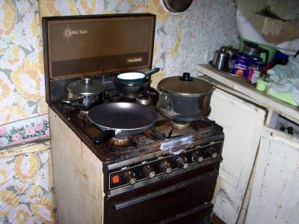
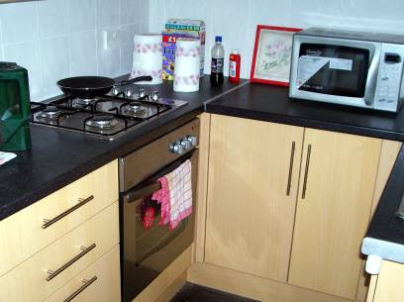
Technical Support

Slide 12
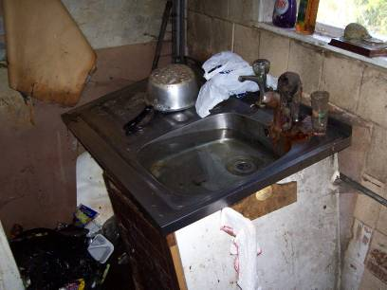
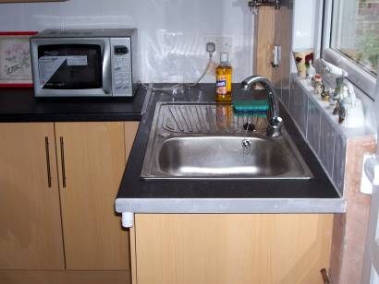
Technical Support

Slide 13
Caseworker Support
Home visiting, client led service
Bereavement support
Income maximisation
Housing options
Reduce social isolation
Introducing appropriate community services to promote independence
One off emergency cleaning/decluttering
Enhanced service in North (including welfare grant)
Additional annualised income last year £1,344,700
Improved diet, warmer home, improved access to social activities

Slide 14
Hints and tips
Find an ally who “gets it”
Don’t let information sharing be an insurmountable barrier
Make friends with IT/Business Intelligence
If you are asked if you can do something say “yes” and then work out how to do it
Demonstrate that you have robust policies, procedures and data capture systems
Try to build relationships of mutual trust with commissioners and referrers
Let the NHS be pleasantly surprised by how quickly you can mobilise
Stay true to your mission/values

Slide 15
Thank you for listening
Janette Linacre
jlinacre@careandrepair-manchester.org.uk
www.careandrepair-manchester.org.uk
0161 872 5500

