Slide 1
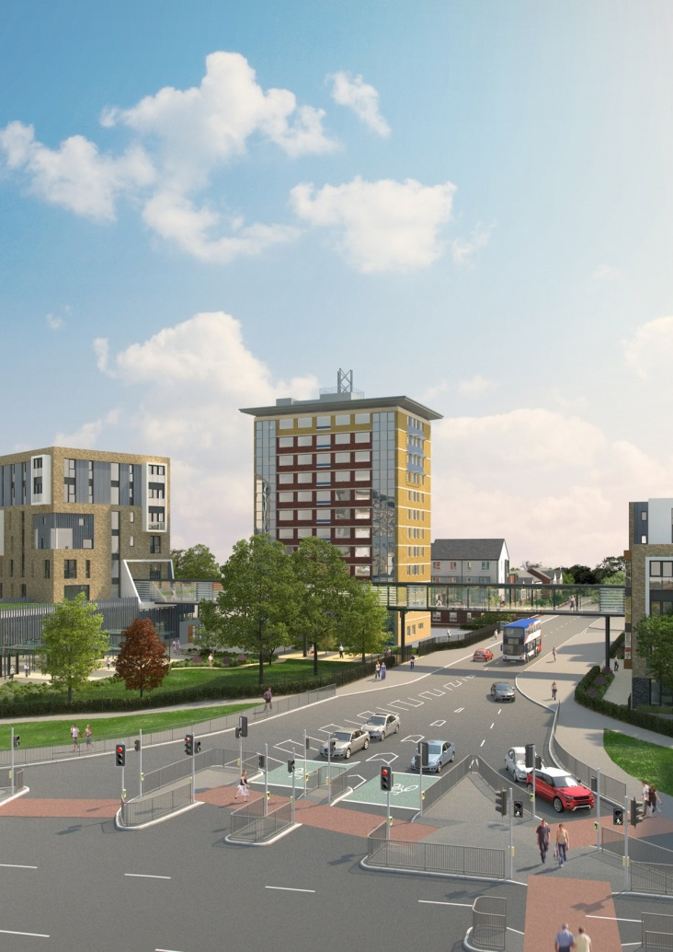
Manchester Voluntary Sector Assembly

Slide 2
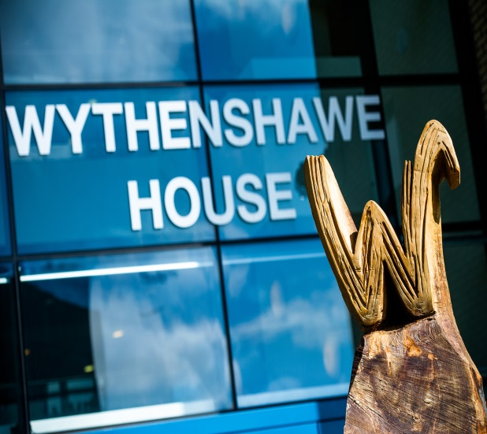
Future of social housing providers & relationship with voluntary community & social enterprise sector & role in wider community
Nigel Wilson
Group Chief Executive
Wythenshawe Community Housing Group

Slide 3

Background
Personal view
Challenges/Opportunities
Reflections

Slide 4

BACKGROUND
258,000 houses in Greater Manchester
1:5 homes in City Region owned or managed by H.P
500,000 residents housed
£72 million of inward investment in 15/16 across GM

Slide 5
£1.6 million invested in apprenticeships in 15/16
28,000 full time jobs across local communities
7000 residents back into work across GM in 15/16
HP £14 million saved for residents in 15/16 through property reduction

Slide 6

Built 8000 houses in GM over the last 5 years (33% of all new stock)
Spend £442 million maintaining houses in GM – supporting local businesses
Combined annual turnover of £1 billion and assets worth over £6 billion

Slide 7

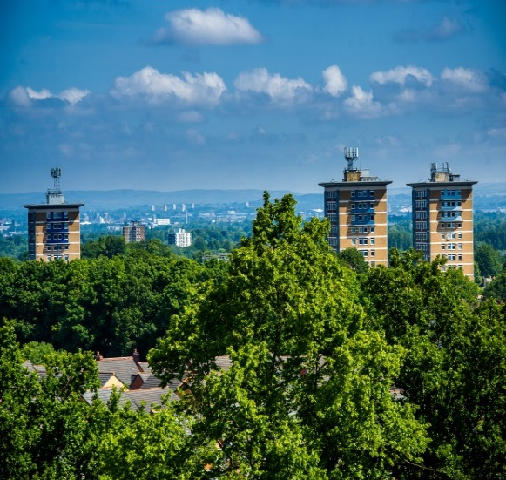
PERSONAL VIEWS
Balance of growth & place
Who do we serve
Joined up solution challenging
Back stop for local service withdrawal
Big vs small. Local vs national
What is affordable
Poverty being hidden
Sanctions bite hard and deep

Slide 8

CHALLENGES/OPPORTUNITIES
Competing for similar resources
Political pressures
Growth at all cost
Aging population living longer, less turnover, less houses available
More people in food, fuel & furniture poverty

Slide 9
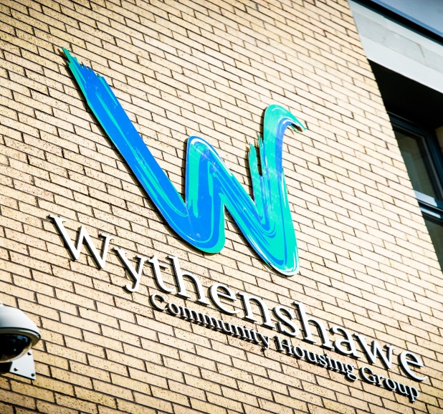
Government softened line on ownership
LHA cap & supported housing critical issue
Homelessness & rough sleeping has attention
Strong spirit collaboration
Mayoral election - focus
Notes:
Each IDA will be bespoke to each RP, adapted to the size, structure, risk profile of the RP;
Normally 6 weeks notice, but can be at short notice if concerns have been identified;
Mixture of desktop research and site visits;
Carried out by a small team, led by a senior HCA staff member – usually includes the usual HCA contact for the RP for consistency;
Purpose of stage 1 – checking to ensure key decisions are robustly discussed and challenged, debate should be suitable reflected in the meeting minutes.
Normally given 2 weeks to submit the data requested – must submit within the set deadline. A missed deadline is an indication of a breach of the Governance & Financial Viability Standard;
Document list issued will include an explanation of why the information is being requested, and which regulatory standard the request relates to;
Documents requested are those RPs are expected to already have, the two week period is for collating and checking for consistency;
If it helps to demonstrate compliance with the relevant standard, provide additional supporting reports, provide a summarised overview and reference appropriate sections;
Further request may be clarification emails or for further reports.
Most frequent question by the HCA will be – How do the Board know… - quality of Board papers and minutes is critical.
Purpose of stage 2 – assess the quality of decision making, is there a good understanding of the RP’s strategy, associated risks?
re interviews with Board members, it is expected that members of the Exec Team are not present.

Slide 10
REFLECTIONS
15 minutes not long enough
Must keep our voice
Whilst world around is chaotic, our residents still suffering
Invest wisely, invest with a social return
Be accountable
Collaboration key
Notes:
Each IDA will be bespoke to each RP, adapted to the size, structure, risk profile of the RP;
Normally 6 weeks notice, but can be at short notice if concerns have been identified;
Mixture of desktop research and site visits;
Carried out by a small team, led by a senior HCA staff member – usually includes the usual HCA contact for the RP for consistency;
Purpose of stage 1 – checking to ensure key decisions are robustly discussed and challenged, debate should be suitable reflected in the meeting minutes.
Normally given 2 weeks to submit the data requested – must submit within the set deadline. A missed deadline is an indication of a breach of the Governance & Financial Viability Standard;
Document list issued will include an explanation of why the information is being requested, and which regulatory standard the request relates to;
Documents requested are those RPs are expected to already have, the two week period is for collating and checking for consistency;
If it helps to demonstrate compliance with the relevant standard, provide additional supporting reports, provide a summarised overview and reference appropriate sections;
Further request may be clarification emails or for further reports.
Most frequent question by the HCA will be – How do the Board know… - quality of Board papers and minutes is critical.
Purpose of stage 2 – assess the quality of decision making, is there a good understanding of the RP’s strategy, associated risks?
re interviews with Board members, it is expected that members of the Exec Team are not present.

Slide 11

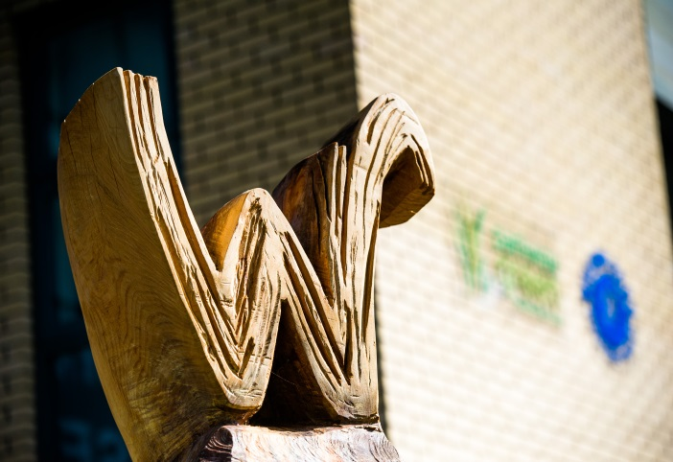

Questions?

