Slide 1
Single Hospital Service update
Paul Nethercott
Community Partnership Manager
Manchester University NHS Foundation Trust

Slide 2
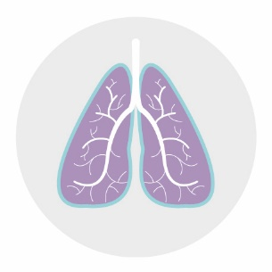
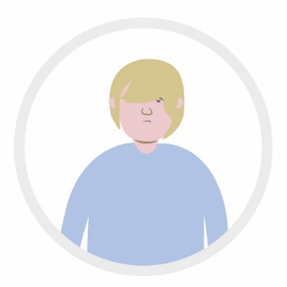
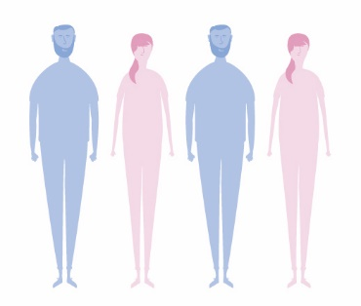
Why are we creating a Single Hospital Service?
Manchester has the highest rate of early death from respiratory (breathing) diseases in England. More than 64% of these deaths are considered to be preventable.
Manchester has one of the highest rates of child poverty in the country; with just over 32% of children aged under 16 living in poverty, and many live in homes where no-one is employed.
Nearly 4,000 people aged 16–64 in Manchester were long-term unemployed in 2014. This was 10.5% of the Manchester population.
In August 2015, there were 2,895 patients in Manchester diagnosed
with dementia. The vast majority (95%) of these patients are aged 65 and over.
We have the highest number of smoking-related deaths in the country. Each year there are some 735 deaths and 4,760 hospital admissions due to smoking
Some 350 people under the age of 75 die from cardiovascular (heart) disease in Manchester each year.
In Trafford there is less deprivation but an older population

Slide 3
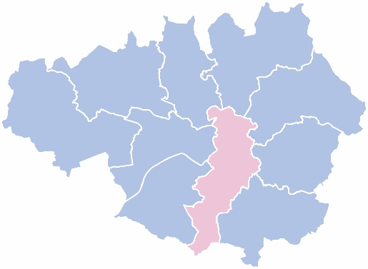
The case for change
Hospital services in our locality are facing a number of challenges:
Care is fragmented - resulting in an unacceptable variation in care
Staffing challenges and the need to move to consistent 7- day services for our patients
Increased demand for services
Financial deficits and sustainability
Sir Jonathan Michael independent review for Manchester Health and Wellbeing Board
Agreed to create a new, city-wide hospital Trust for City of Manchester, Trafford and the communities we serve.

Slide 4
What is our vision?
Creating a new NHS Foundation Trust provides the ideal platform to deliver the benefits of a Single Hospital Service to the population of Manchester, Trafford and the wider region.
The new organisation will improve the health and quality of life of our diverse population by building an organisation that:
Excels in quality, safety and patient experience
Is recognised internationally as a leading healthcare provider
Attracts, develops and retains great people
Plays its full part in the GM health and social care economy
Undertakes large scale research, innovation and teaching for the benefit of the NHS

Slide 5
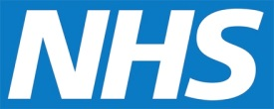
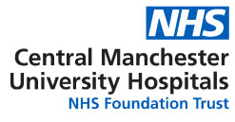
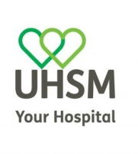
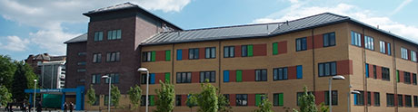
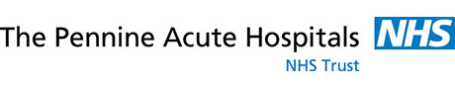
Single Hospital Service
Hospitals in the new Trust Trust they are now in
Manchester Royal Infirmary (MRI)
St. Mary’s Hospital
Royal Manchester Children’s Hospital
Manchester Royal Eye Hospital
University Dental Hospital of Manchester
Trafford General Hospital
Altrincham Hospital
Wythenshawe Hospital
Withington Community Hospital
North Manchester General Hospital
5

Slide 6
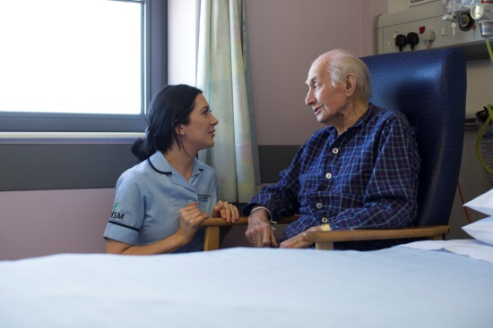
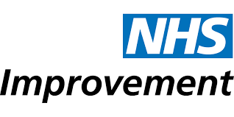
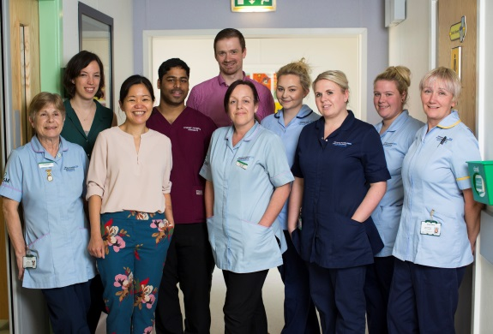
What have we achieved before Oct 2017?
Competition Case
Patient Benefits Case
Full Business Case
PTIP (Post-Transaction Integration Plan)

Slide 7
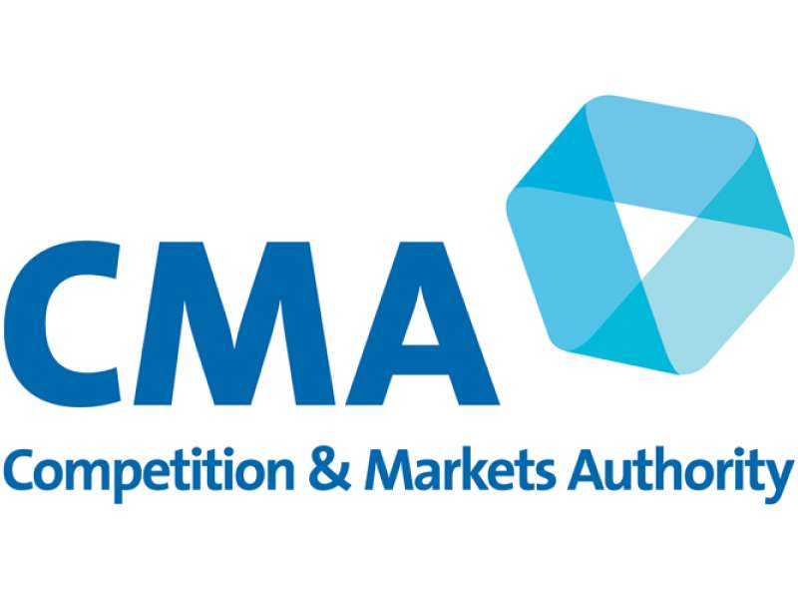
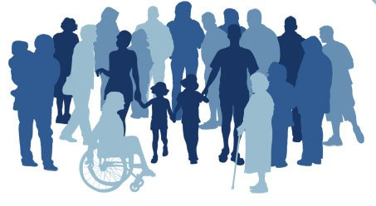
“The CMA has cleared the merger between the two Manchester hospital Trusts as it will be of overall benefit to patients.
Patients who are expected to benefit from the merger include those at risk of heart attacks or strokes, and those who need vascular surgery or kidney stone removal.”
- 1st August 2017

Slide 8
Full Business Case & Integration Plan Submitted
Full Business Case Appraisal Process
Advised CMA on Patient Benefits Case
Process on track achieved Sept 2017

Slide 9
Widespread Engagement
5
Clinical Leads
500+
Clinicians Engaged
3,000+
responses
Patient Benefits Cases
15
Months of Consultation
13

Slide 10
New Foundation Trust – New Name:
From 1st October 2017
All hospitals will keep their current names and have a strong identity in the new Trust e.g.
Wythenshawe Hospital, Trafford General Hospital

Slide 11
Successes to date: October 2017 – January 2018
Governing Body elected including links to Community Partners.
Board and Executive in place.
SHS Integration process Day 1 targets met and day 1 -100 on target to be achieved.
Team integration process began.
Opportunities to build on 2 organisations strengths.

